Slide 1


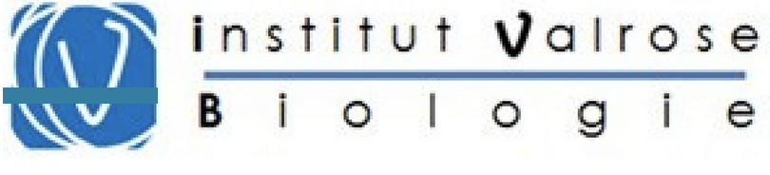


SASI vs SADI
Antonio IANNELLI, MD, PhD
Clinique du Parc Impérial (SEDNA), 28 Bd Tzarewitch, 06000 Nice, France
Institut de Biologie Valrose Unité 1091, F-06100 Nice, France
University of Nice Côte d’Azur

Slide 2
Agenda
Preamble

Slide 3
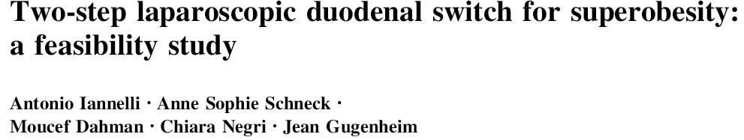


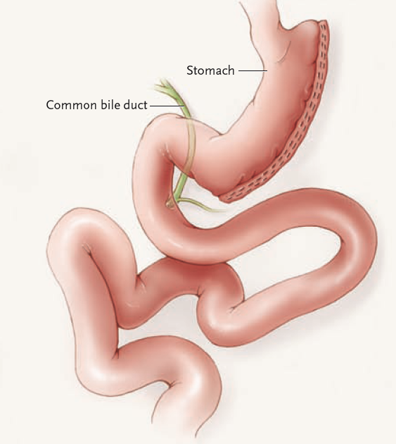
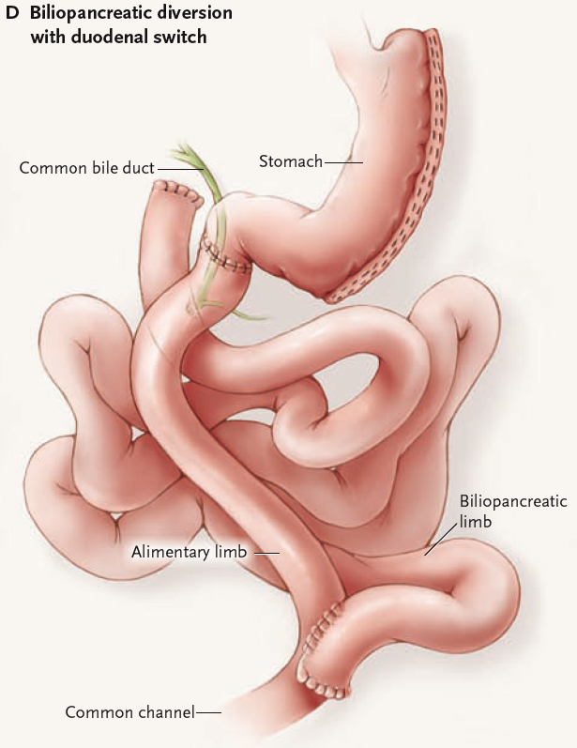
Preamble
We started with LDS in 2007
LSG
LDS
Iannelli et al Surg Endosc 2009

Slide 4
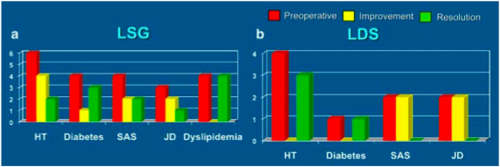
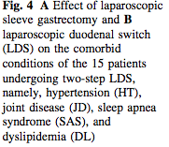
Preamble
We started with LDS in 2007
Iannelli et al Surg Endosc 2009

Slide 5
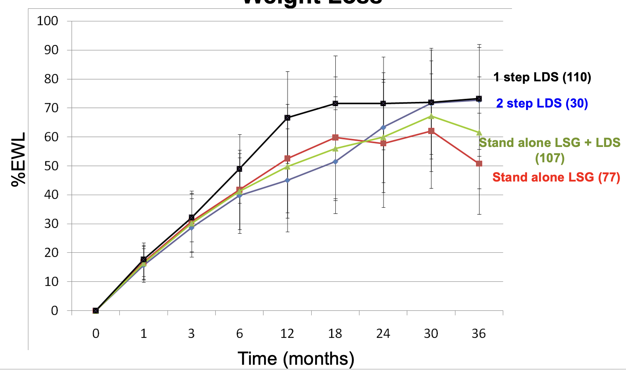
Preamble
One vs two-step does not impact weight loss
Iannelli et al SOARD 2013

Slide 6
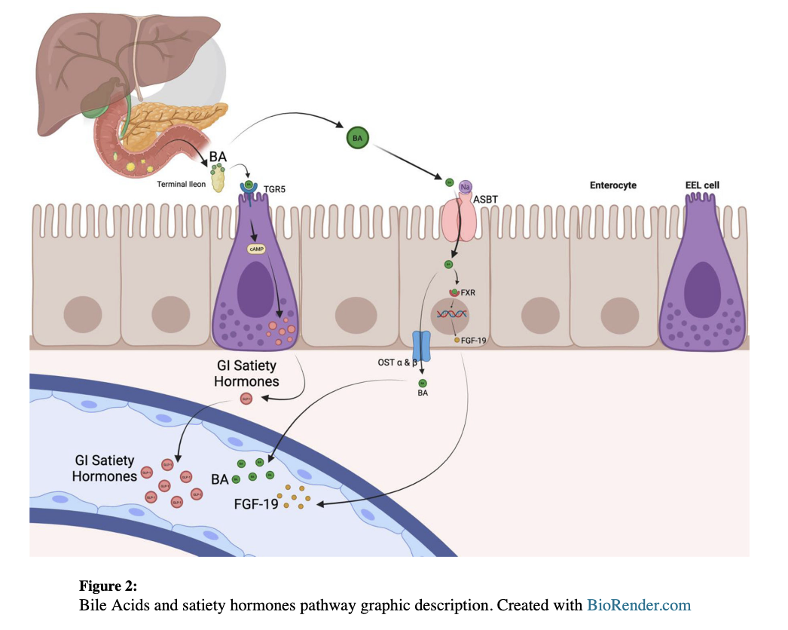
Preamble
Distal gut hypertrophy and gut hormones secretion
Feris et al SOARD 2025

Slide 7
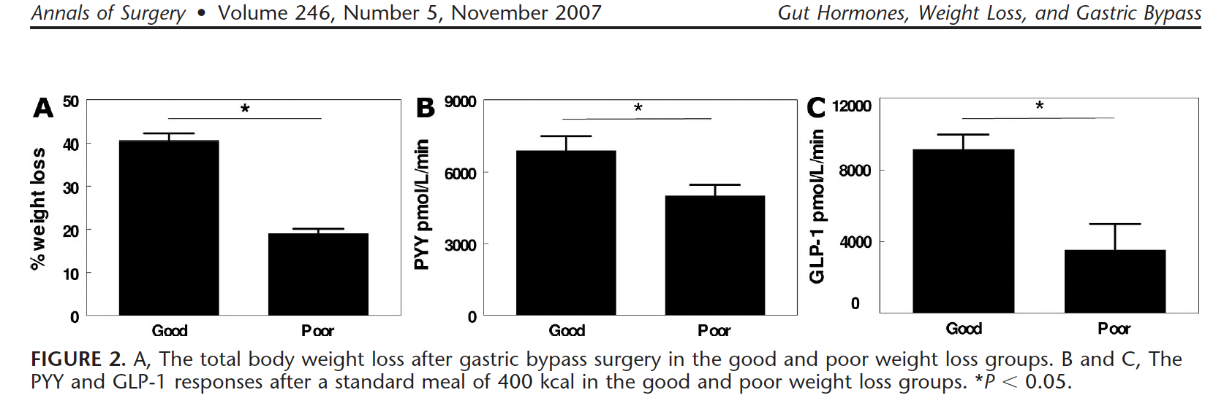
Preamble
Poor weigh loss after surgery correlates with poor gut hormones secretion
Le Roux et al Ann Surg 2007

Slide 8
Agenda
Preamble
Second step SASI for failed SG

Slide 9
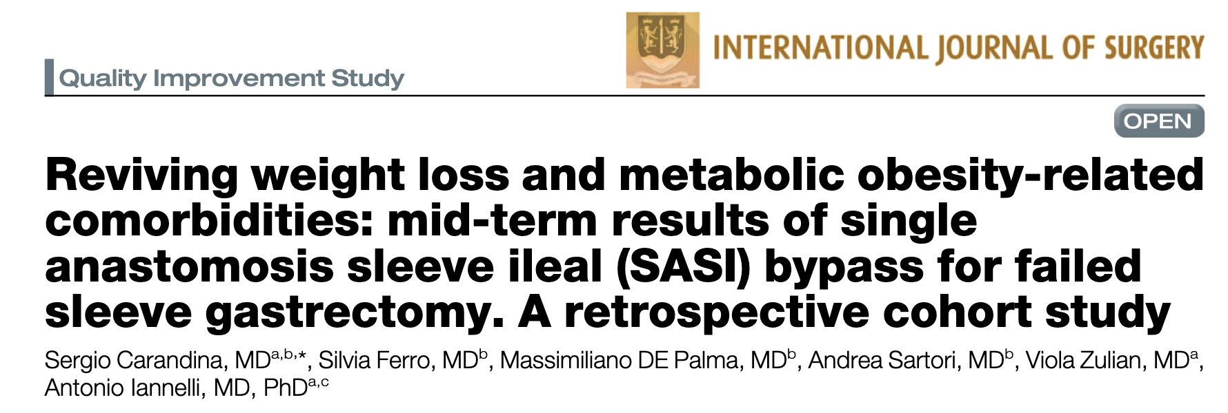
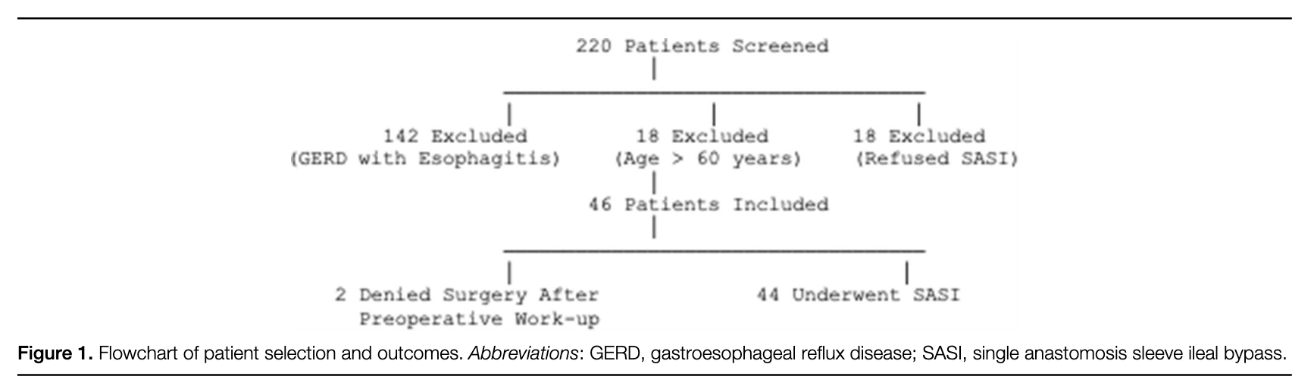
SASI as a second step procedure for failed SG
25% of failed SG are eligible
Carandina et al Int J Surg 2025

Slide 10
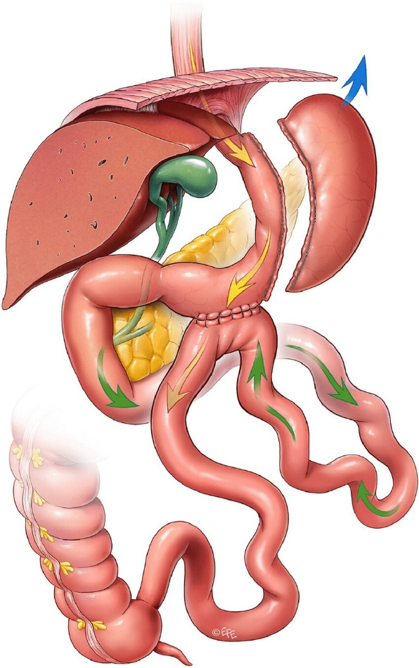
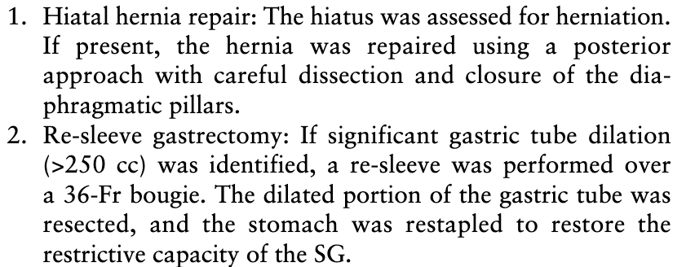
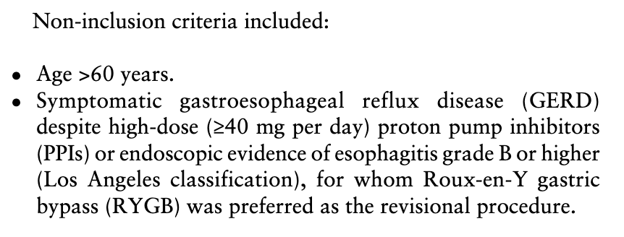
SASI as a second step procedure for failed SG
Relevant technical and study design details
3 cm gasto-ileal anastomosis
250–300 cm ileal loop (depending on BMI)
Carandina et al Int J Surg 2025

Slide 11
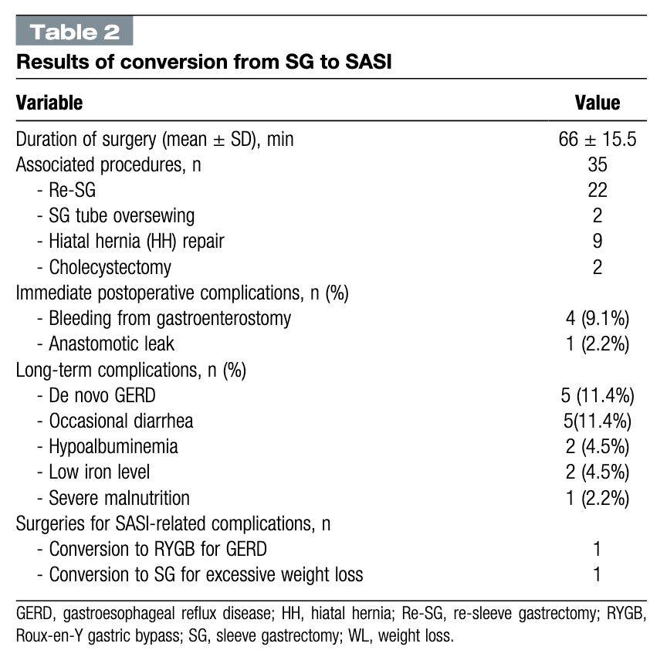
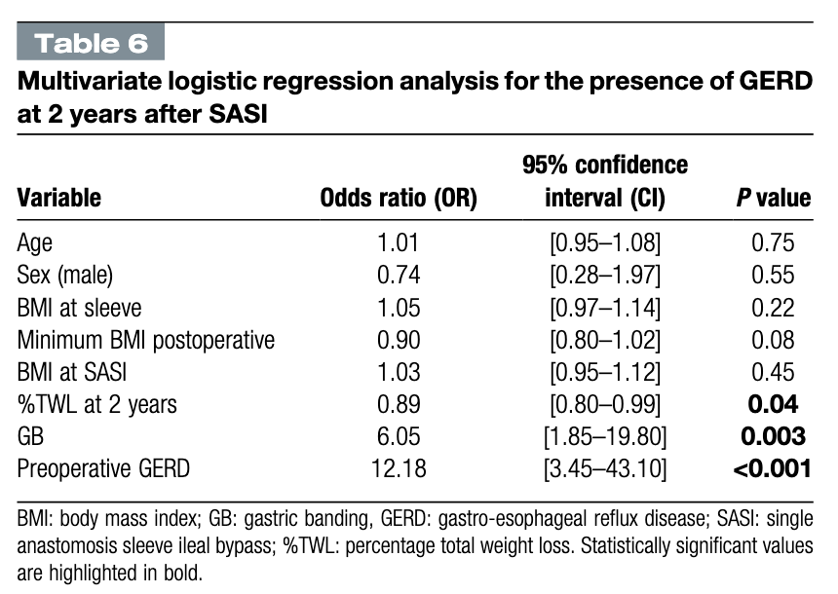
SASI as a second step procedure for failed SG
Results of surgery
Carandina et al Int J Surg 2025

Slide 12
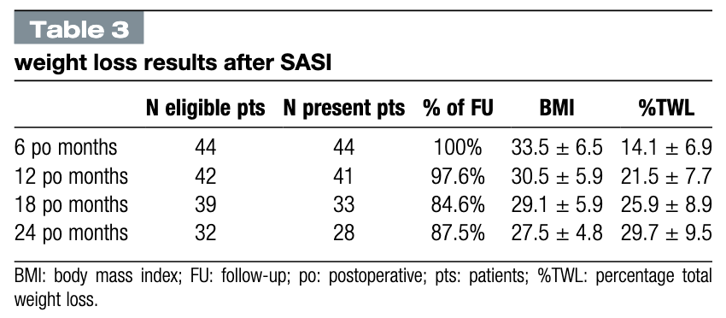
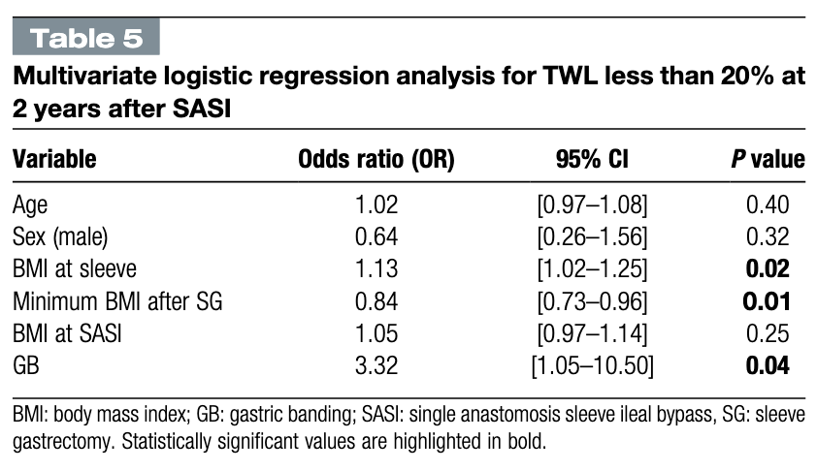
SASI as a second step procedure for failed SG
Weight loss
Carandina et al Int J Surg 2025

Slide 13
Agenda
Preamble
Second step SASI for failed SG
Comparing SASI to SADI

Slide 14
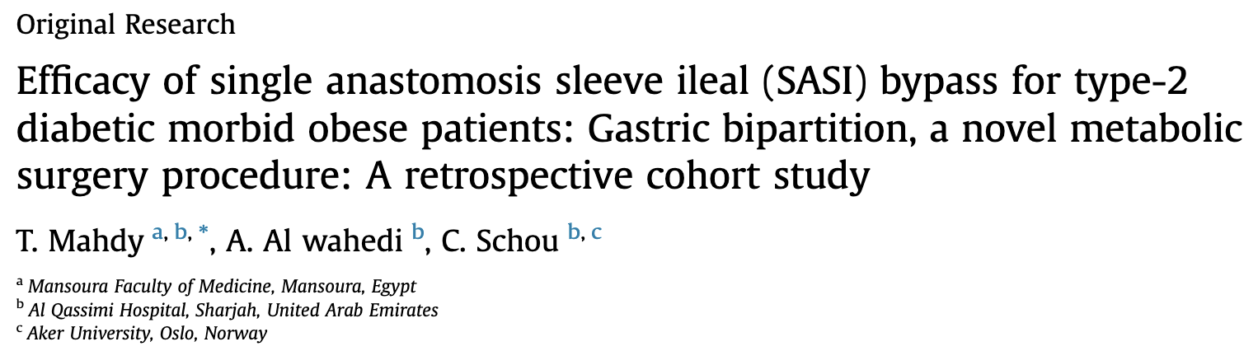
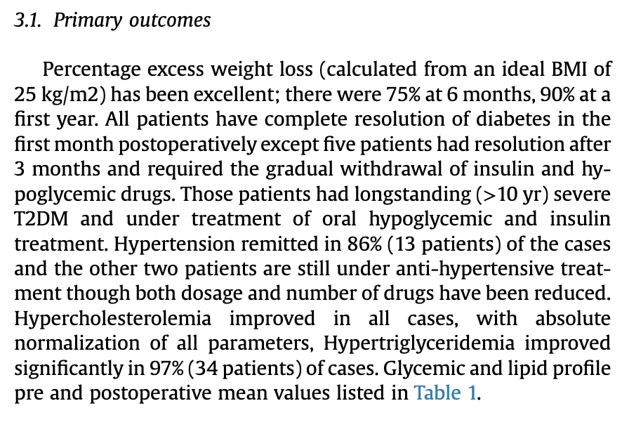
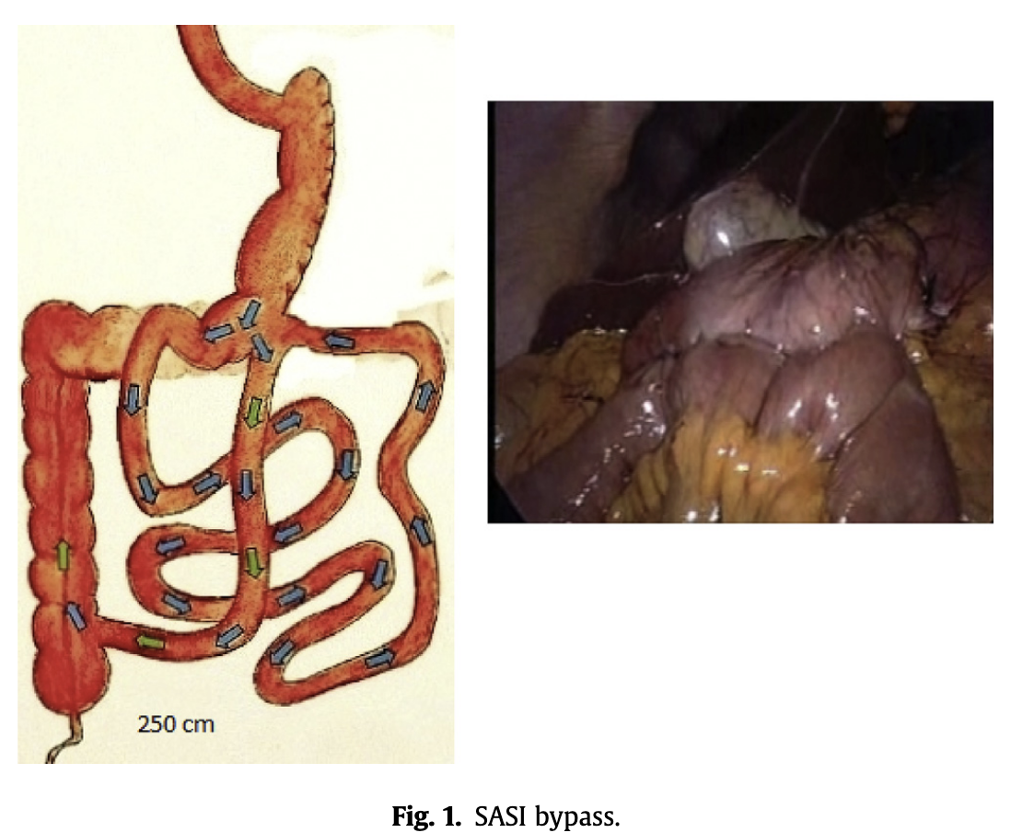
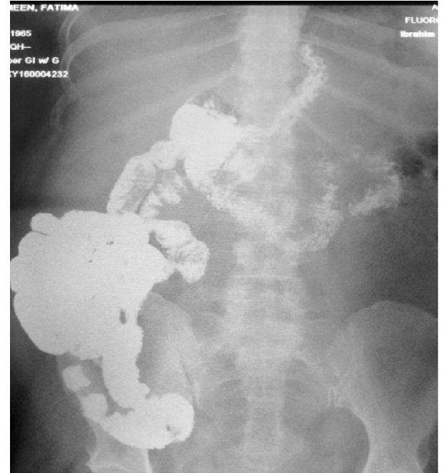
SASI as a second step procedure for failed SG
SASI at the sunrise
1 case out of 50 with marginal ulcer)
Mahdy et al Int J Surg 2016

Slide 15
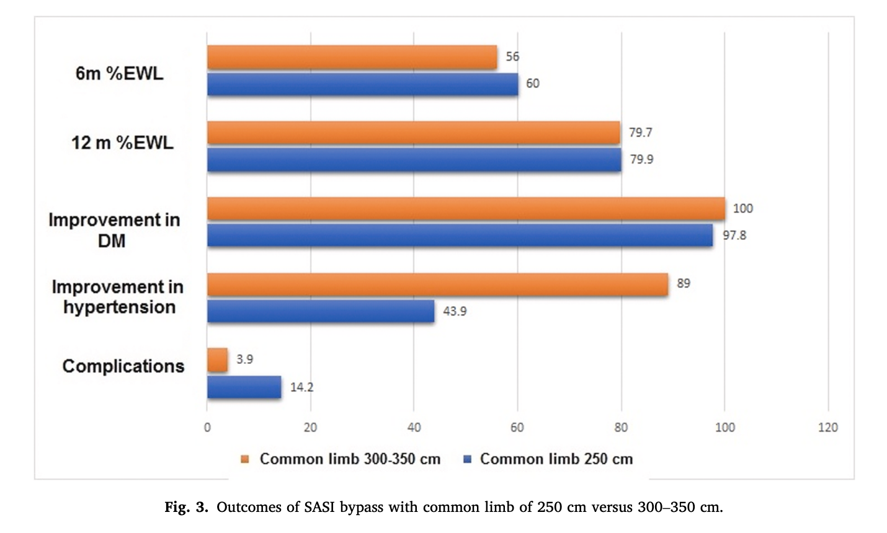
SASI as a second step procedure for failed SG
The length of common channel
Emile et al Int J Surg 2021

Slide 16
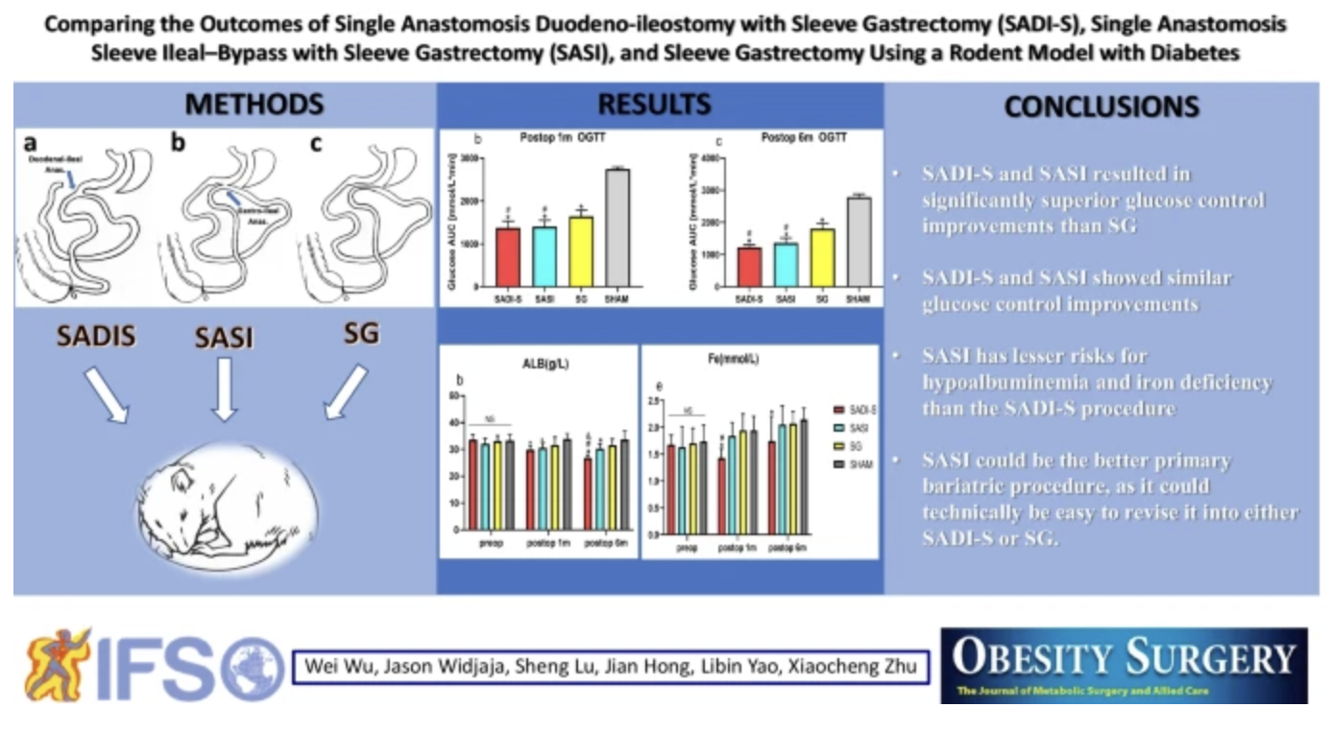
SASI as a second step procedure for failed SG
There is no study comapring SADI to SASI in humans
Wu W et al. Obes Surg 2022

Slide 17
SASI vs SADI as a second step procedure for failed SG
Naïve unadjusted cross-trial (between-study) comparison using aggregate data
%TWL at 24 months P
SADI-SLEEVE (Robert et al.) 33.3 ± 11.81
0.03
Carandina et al. 29.7 ± 9.5
Statistically, the mean %TWL is higher in SADI-SLEEVE (Robert et al.) than in Carandina et al. (+3.6 points; p ≈ 0.03; 95% CI [0.28, 6.92]). Effect size is modest (g = 0.31).
Non-randomized cross-study comparison: populations, follow-up, the way %TWL is computed, inclusion criteria, etc., may differ (risk of confounding bias).
The test assumes independent observations within each study and a comparable measurement of %TWL.
No adjustement for age, sex, baseline BMI, follow-up duration, etc.
Robert et al Lancet 2025; Carandina et al Int J Surg 2025

Slide 18
Agenda
Preamble
Second step SASI for failed SG
Comparing SASI to SADI
Conclusion and perspective

Slide 19
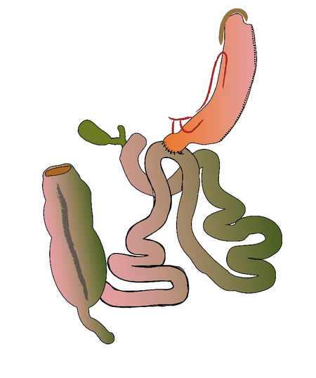
SASI as a second step procedure for failed SG
SASI vs SADI
Weight loss similar to SADI
But a lot simpler and safer than SADI
Very high resolution of T2DM as SADI
No excluded segments
All limbs are alimentary
No significant malabsorption
Functional restriction (instead of mechanical)
Easier to reverse (to RYGB for GERD)
Immediate ileal nutritive stimulus as SADI
Full endoscopic access
Lowers intra‑gastric pressure (effect on GERD?)
Endoscopic adjustments

Slide 20
SASI vs SADI as a second step procedure for failed SG
Building a comparative study from historical series
Open to all surgeons doing SASI and or SADI
Data collection in a standardized Excel file
Inclusion criteria
Participating surgeons (hands-on experience with SASI and or SASI)
Minimum follow-up 1 year
Data on po complications, nutritional issues, weight loss, rate of T2D remission, GERD
Primary outcome (composite)
Weight loss difference between the two proceudures + remission T2D
Secondary outcomes
Nutritional issues
Need for revision
GERD evolution
Contact Dr Francesco Angrisani
francescoangrisani11@gmail.com

